Slide 1
Instructions
Instruction
  Direction/command given to a computer.
  Causes electrical signals to be sent through specific circuits for processing.
Instruction set
  Design defines a collection of functions performed by the processor.
  Differentiates computer architecture by the………
    Number of instructions
    Complexity of operations performed by individual instructions
    Data types supported
    Format (layout, fixed vs. variable length)
    Use of registers
    Addressing (size, modes)

Slide 2
Instruction Set Design
software
The ISA is what the user and the compiler sees
The ISA is what the hardware needs to implement
instruction set
hardware
Notes:
An instruction set, or instruction set architecture (ISA), is the part of the computer architecture related to programming, including the native data types, instructions, registers, addressing modes, memory architecture, interrupt and exception handling, and external I/O. An ISA includes a specification of the set of opcodes (machine language), the native commands implemented by a particular CPU design
Computers with different microarchitectures can share a common instruction set. For example, the Intel Pentium and the AMD Athlon implement nearly identical versions of the x86 instruction set, but have radically different internal designs.

Slide 3
Instruction Format
OP-CODE: task
Source OPERAND(s)
Result OPERAND
  Location of data (register, memory)
    Explicit : included in instruction
    Implicit : default assumed
Addresses
Source
OPERAND
Result
OPERAND
OP-CODE

Slide 4
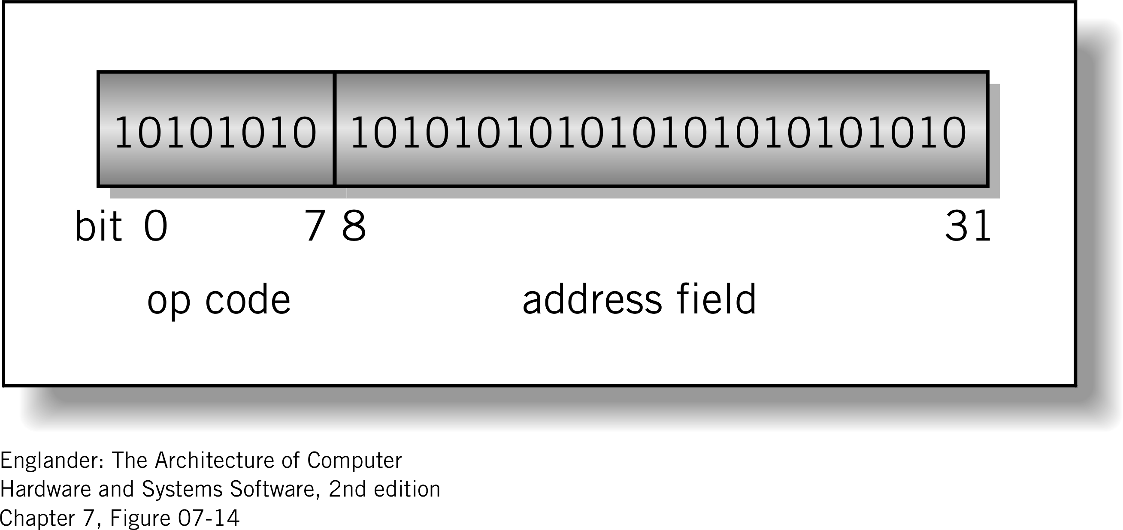
Instruction Format
Machine-specific template that specifies:-
  Length of the op-code
  Number of operands
  Length of operands
Simple
32-bit Instruction Format
Notes:
Instructions are represented as numbers
Implications on instruction REPRESENTATION and CODING

Slide 5
Instruction-Set Design Issues
Which instructions to include:
  How many?
  Complexity
Which built-in data types: integer, floating point, character, etc.
Instruction format:
  Length (fixed, variable)
  number of address (2, 3, etc)
  field sizes
Number of registers
Addressing modes supported
  how are the memory addresses of variables/data determining

Slide 6
The challenge
Provide enough op-code bits to support a sufficient set of instructions as well as plenty of address bits to use memory effectively
SIZE ?
Opcode SIZE ?
Data SIZE ?
How many operations?
How many kinds of data?
4-bit opcode Will allow 16-different functions | 12-bit operand 4096 memory address

Slide 7
Quick Review Question 1
Consider a computer that is used for simple numerical problems. It uses 9 bits for an opcode, and 25 bits for a memory address.
  What is the size of its instruction? _______ bits
  How many different instructions can it have? _______
  What is the maximum memory size that it can address? _________ (Hint: Assume that 2^20 is about 1M).
Notes:
a) 9 + 25 = 34 bits
b) 2⁹ = 512 instructions
c) 2²⁵ = 2⁵ x 2²⁰ = 32 MB

Slide 8
Quick Review Question 2
Given a CPU with a 8-bit word, 8 registers, and instructions that are exactly 1 word long and which has 2 operands:
  How long can the opcode field be in an instruction?
  How many instructions can the CPU support?
Notes:
2 bits
2² = 4

Slide 9
Number of Operands
Most contemporary computers have two and three address instructions; reasons:
Fewer addresses per instruction
  simplifies the instruction format,
  reduces the instruction length
  and the complexity of the CPU
However instructions
  become more primitive.
The larger the size and greater the number of addresses, the longer the instruction, the longer the decode time and the more complex the CPU

Slide 10
1, 2 and 3 Operand Examples
Instruction Comment
SUB Y, A, B Y ← A – B
MPY T, D, E T ← D * E
ADD T, T, C T ← T + C
DIV Y, Y, T Y ← Y / T
Using three addresses
Instruction Comment
LOAD D AC ← D
MPY E AC ← D * E
ADD C AC ← AC + C
STOR Y Y ← AC
LOAD A AC ← A
SUB B AC ← AC – B
DIV Y AC ← AC / Y
STOR Y Y ← AC
Using one address
Instruction Comment
MOVE Y, A Y ← A
SUB Y, B Y ← Y – B
MOVE T, D T ← D
MPY T, E T ← T * E
ADD T, C T ← T + C
DIV Y, T Y ← Y / T
Using two addresses
Here we compare the length of code if we have one address instructions, two address instructions and three address instructions, each computes
Y = (A – B) / (C + D * E)
Notice: one and two address operand instructions write over a source operand, thus destroying data

Slide 11
Type of Operand
The source and result operands may be in
  main or virtual memory
  CPU register
  I/O device
The type of operand that an instruction can specify has an impact on instruction sizes
  Consider the instruction Add R1, R2, R3
    Add op code is 6 bits
    Assume 32 registers, each takes 5 bits
    This instruction is 21 bits long
  Consider Add X, Y, Z
    Assume 256 MB of memory
    Each memory reference is 28 bits
    This instruction is 90 bits long!

Slide 12
Variable Vs Fixed length
The challenge
  Operand may be in main or virtual memory, CPU register or I/O device
  Instruction length will vary
  One size fits all???
Solution 1 → Variable-Length Instructions
Solution 2 → Fixed-Length Instructions

Slide 13
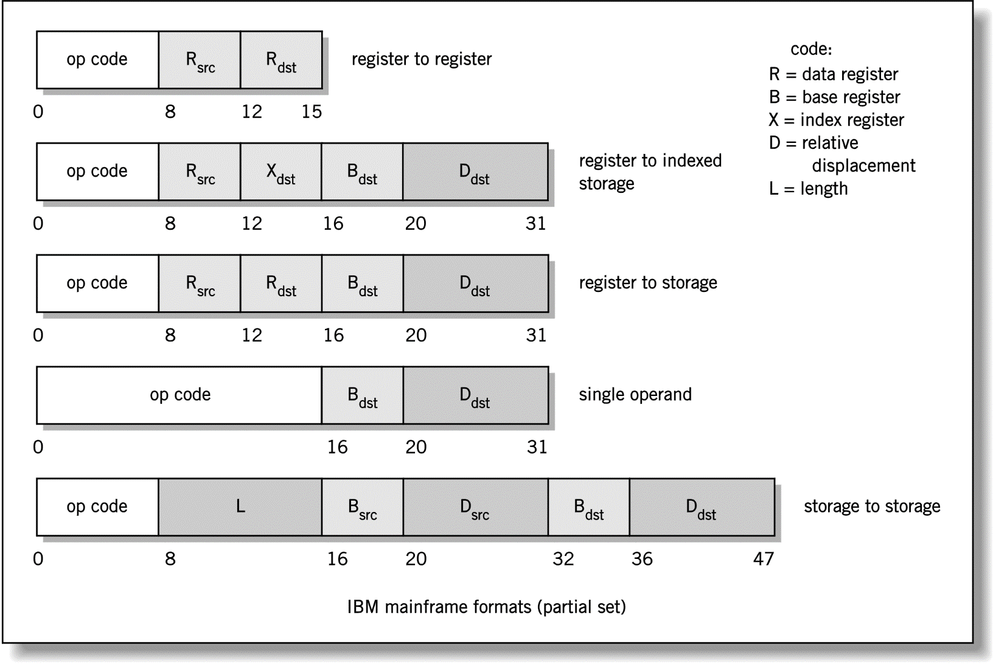
Instruction Formats: CISC

Slide 14
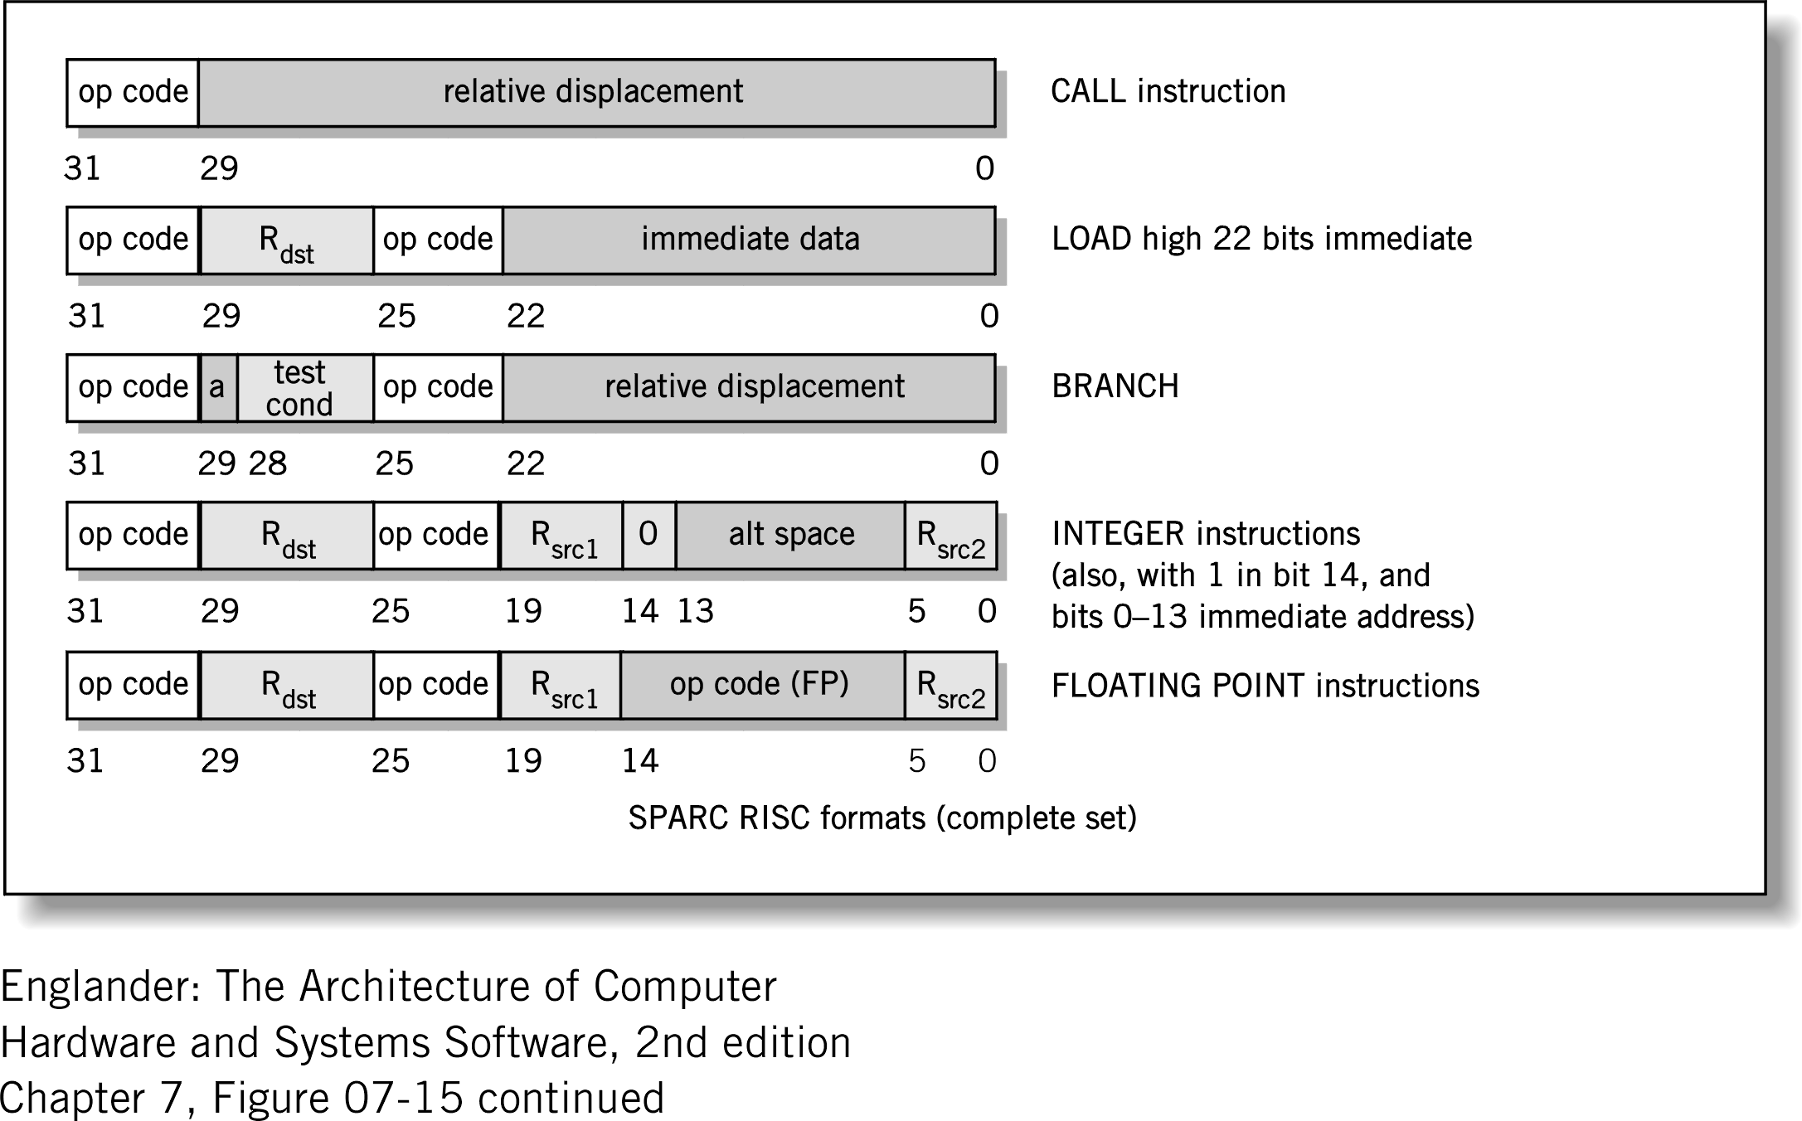
Instruction Formats: RISC

Slide 15
Variable Vs Fixed length
Variable length format
  Simple instructions are short - maybe even only a single byte long
  Advantage = efficient memory use since instructions only use what they need
  Disadvantage = complicates pipelining to increase CPU processing speed
Fixed Length format
  All instructions are the same size
  Advantage = can use pipelining
  Disadvantage = inefficient memory usage
Almost all new CPUs exclusively use fixed-length instructions.

Slide 16
Classification Of Instructions
Instruction sets vary among different processors and are fundamental to their cost, speed and functionality.
However, some instructions are fundamental to all processor architectures
Instructions can be classified into 2 Categories:-
  Privileged Instructions
    Control functions internal to the CPU and are accessible only to the Operating System.
    For example : Halt instruction (don’t want other users to stop a computer while other users are still using it).
  User Accessible Instructions
    Functions that are made accessible to the user programs that are executing within the computer.

Slide 17
User Accessible Instructions
Data Transfer (load, store)
  Most common, greatest flexibility
  Involves data transfer between memory and registers
  What’s a word ? 16bits? 32bits? 64bits?
Arithmetic
  Operators + - / * ^
  Integers and floating point
Logical or Boolean
  Relational operators: > < =
  Boolean operators AND, OR, XOR, NOR, and NOT

Slide 18
User Accessible Instructions (Cont.)
Single Operand Manipulation Instructions
  Negating a value, incrementing, decrementing, setting a register to zero.
Bit Manipulation Instructions
  For setting and resetting individual bits in a data word.
  Allow programmers to create their own flags.
  Pre-created flags
    Carry/borrow, overflow arithmetic flags.

Slide 19
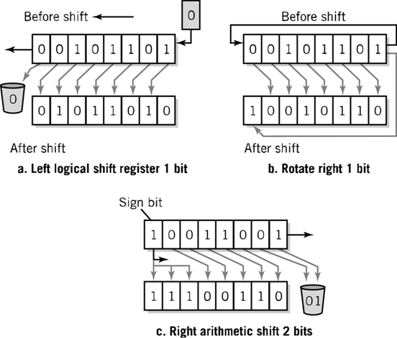
Register Shifts and Rotates

Slide 20
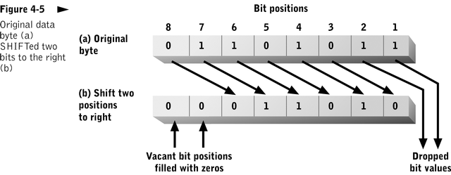
The Shift instruction
The Shift instruction moves bit strings to the left or the right.

Slide 21
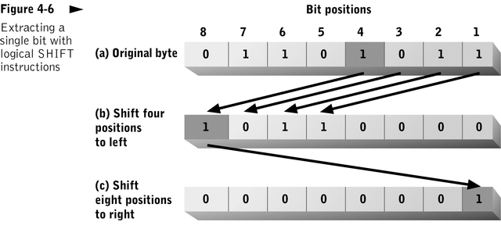
The Logical Shift
The Logical Shift instruction is typically used to extract a single bit from a bit string.

Slide 22
The Arithmetic Shift
The Arithmetic Shift instruction performs multiplication or division.
Multiplication – shifting one bit to the left, multiplies the value by 2.
Division – shifting one bit to the right, divides the value by 2.

Slide 23
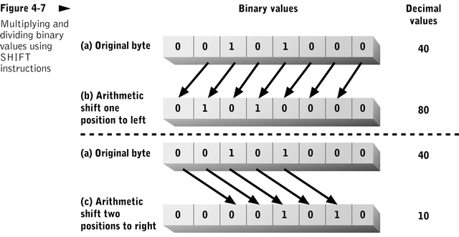
Multiplying & Dividing

Slide 24
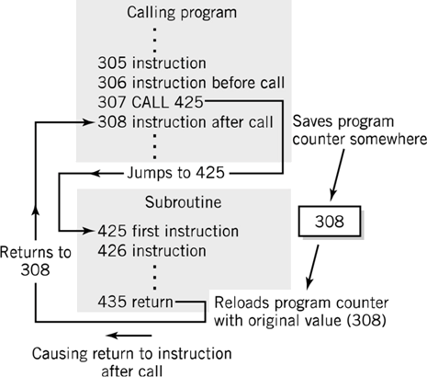
Program Control Instructions
Program control
  change sequence of program execution by changing the program counter
  allows loops, decisions, and subroutines
    Jump causes the processor to always depart from the normal sequence.
    Branch occurs only if a specified condition is met.
    Subroutine call
    and return

Slide 25
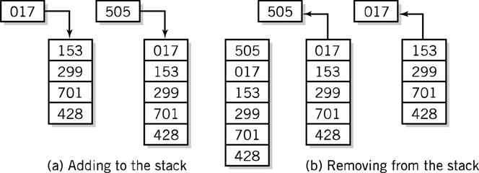
Stack Instructions
Stack instructions
  LIFO method for organising information.
  Items removed in the reverse order from that in which they are added.

Slide 26
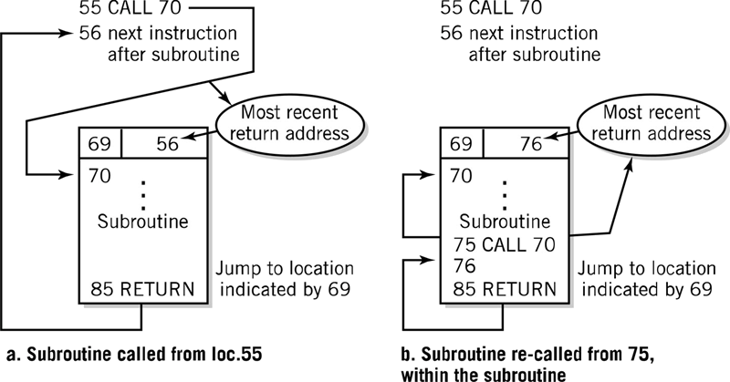
Fixed Location Subroutine Return Address Storage

Slide 27
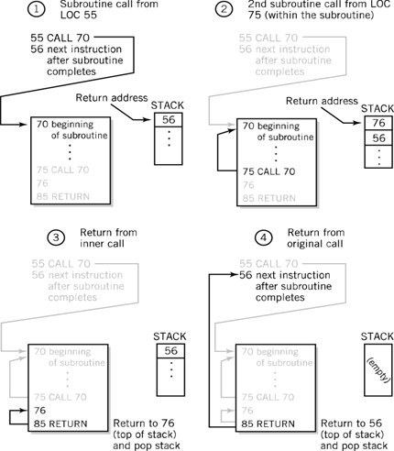
Stack Subroutine Return Address Storage
Notes:
CPU must save the return address so that the RETURN can take place. This is done using the STACK. A CALL pushes the address on the stack
A RETURN pops the address from the top of stack

Slide 28
Stack Subroutine Return Address Storage

Slide 29
Stack Subroutine Return Address Storage

Slide 30
Stack Subroutine Return Address Storage

Slide 31
Multiple Data Instruction
Multiple Data Instruction
  Instructions that perform a single operation on multiple pieces of data.
  For example:- matrix processing as found on Intel's MMX based CPUs.
  This technology helps speed up processing of data in arrays/vectors such as graphics, sound, moving images.
  Also known by its generic term as SIMD (Single Instruction, Multiple Data Stream).
  Intel is now currently developing a more enhanced version called SSE (Streaming SIMD Extension).

Slide 32
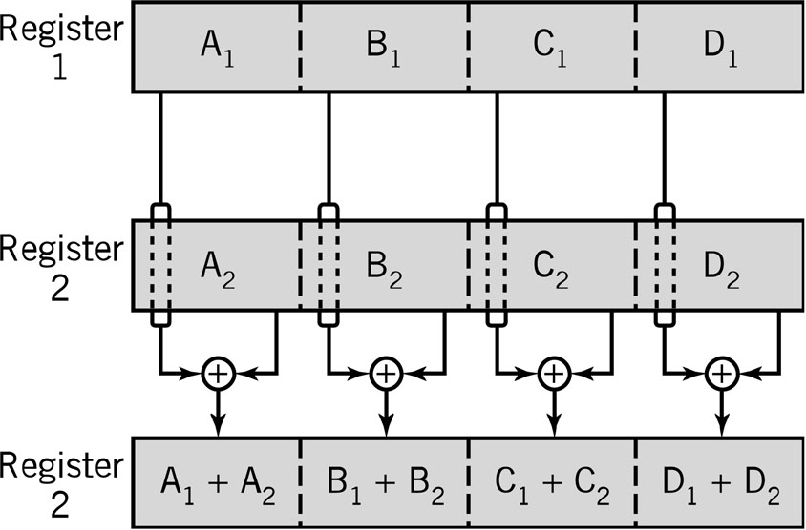
Multiple Data Instruction
Multiple Data Instruction
  Commonly used in vector and array processing applications.

